Slide 1

Feedback Control System Unit 3 Steady state Error

Slide 2
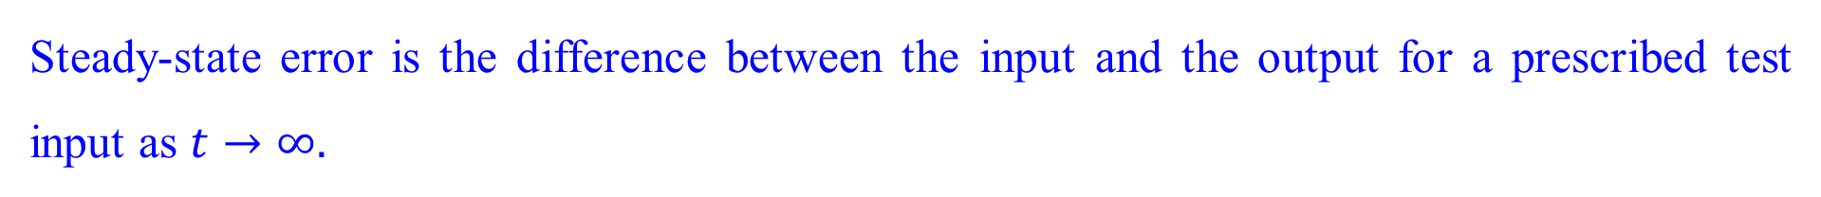
Definition and Test Inputs
Steady-state error is the difference between the input and the output for a prescribed test input as $t→∞.$

Slide 3
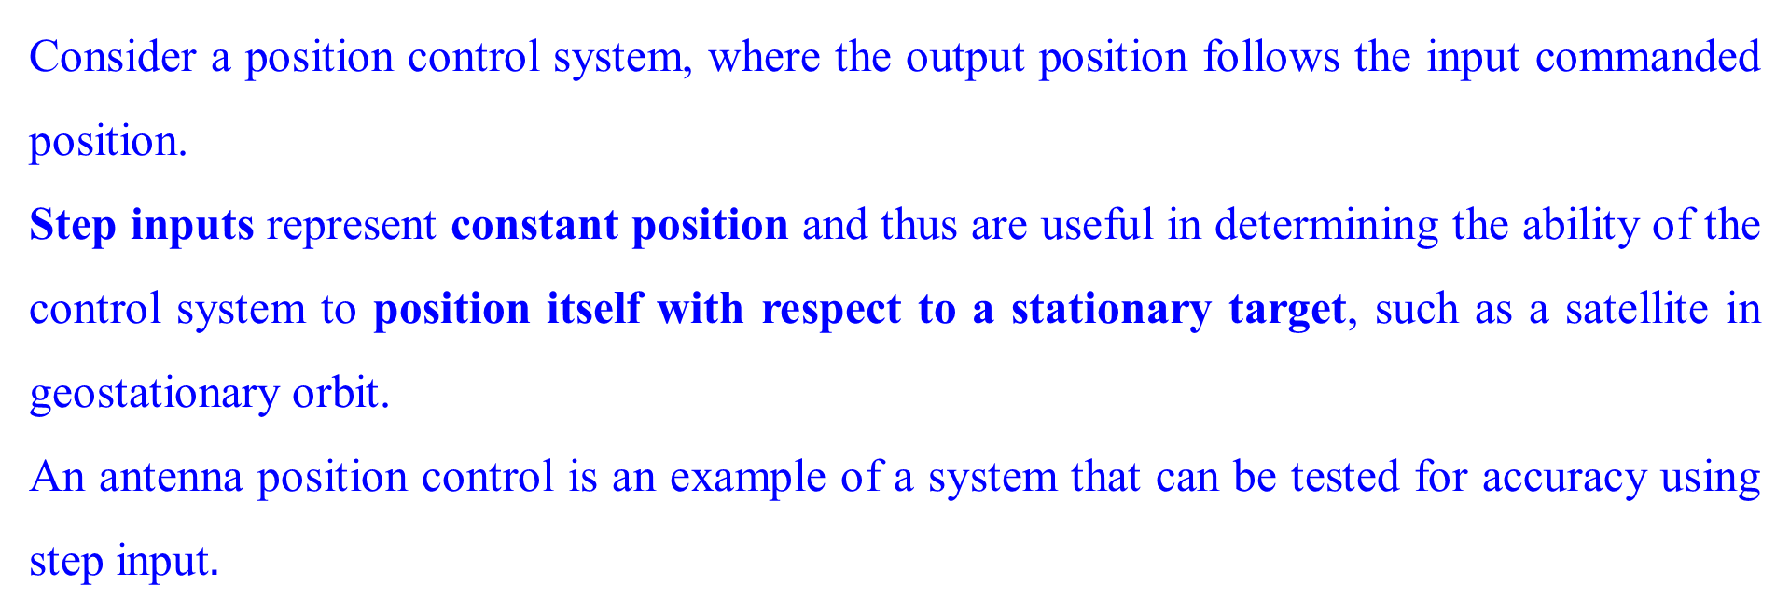
Definition and Test Inputs: Position
Consider a position control system, where the output position follows the input commanded position.
Step inputs represent constant position and thus are useful in determining the ability of the control system to position itself with respect to a stationary target, such as a satellite in geostationary orbit.
An antenna position control is an example of a system that can be tested for accuracy using step input$.$

Slide 4
Definition and Test Inputs: Constant Velocity
Ramp inputs represent constant-velocity inputs to a position control system by their linearly increasing amplitude.
These waveforms can be used to test a system’s ability to follow a linearly increasing input or, equivalently, to track a constant velocity target.
For example, a position control system that tracks a satellite that moves across the sky at a constant angular velocity would be tested with a ramp input to evaluate the steady-state error between the satellite’s angular position and that of the control system.

Slide 5
Definition and Test Inputs: Constant Velocity
Parabola inputs represent constant acceleration inputs to position control systems.
These can be used to represent accelerating targets to determine the steady-state error performance.

Slide 6

Evaluating Steady-State Errors
Consider a system with a step input and two possible outputs. Output 1 has zero steady-state error, and output 2 has a finite steady-state error, $e_{2}(∞)$.

Slide 7

Evaluating Steady-State Errors
Step input is compared with output 1, which has zero steady-state error, and output 2, which has a finite steady-state error, $e_{2}(∞)$, as measured vertically between the input and output 2 after the transients.

Slide 8

Evaluating Steady-State Errors
Consider a system with a ramp input which is compared with output 1, which has zero steady-state error, and output 2, which has a finite steady-state error, $e_{2}(∞)$, as measured vertically between the input and output 2 after the transients.

Slide 9
Evaluating Steady-State Errors
For the ramp input another possibility exists. If the output’s slope is different from that of the input, then output 3 results. Here the steady-state error is infinite as measured vertically between the input and output 3 after the transients have died down, and t approaches infinity.

Slide 10
Evaluating Steady-State Errors
For the ramp input another possibility exists. If the output’s slope is different from that of the input, then output 3 results. Here the steady-state error is infinite as measured vertically between the input and output 3 after the transients have died down, and t approaches infinity.

Slide 11

Evaluating Steady-State Errors
Since the error is the difference between the input and the output of a system, we assume a closed-loop transfer function, $T(s)$, and form the error, $E(s)$, by taking the difference between the input and the output. Here we are interested in the steady-state, or final, value of $e(t)$.

Slide 12
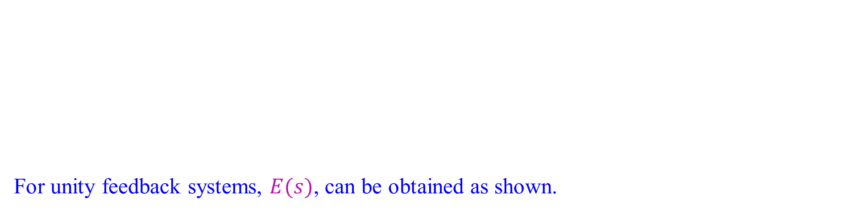
Evaluating Steady-State Errors
For unity feedback systems, $E(s)$, can be obtained as shown.

Slide 13
Sources of Steady-State Error
There are many sources for steady state errors such as backlash in gears or a motor that will not move unless the input voltage exceeds a threshold. These are the nonlinearities which causes the steady state error.
We study here are errors that arise from the configuration of the system itself and the type of applied input.

Slide 14
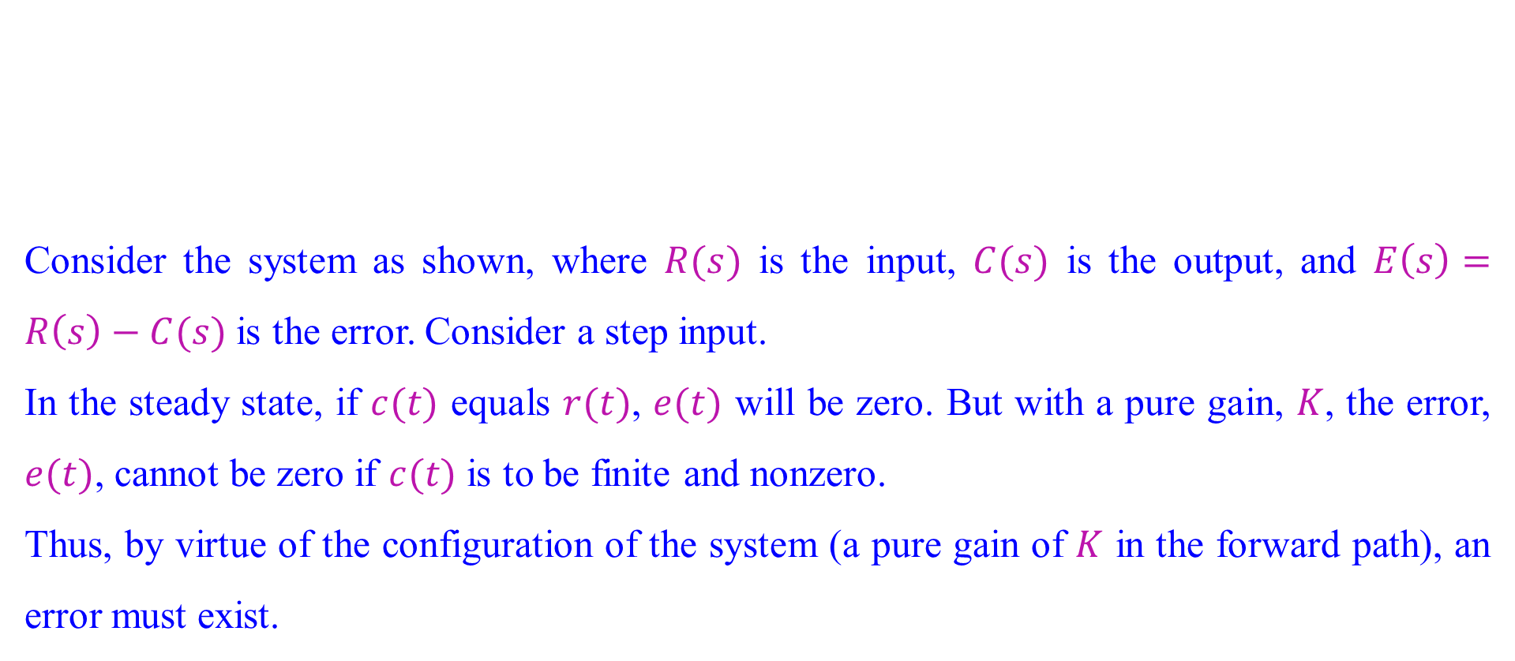
Sources of Steady-State Error
Consider the system as shown, where $R(s)$ is the input, $C(s)$ is the output, and $E\left(s\right)=R\left(s\right)−C(s)$ is the error. Consider a step input.
In the steady state, if $c(t)$ equals $r(t)$, $e(t)$ will be zero. But with a pure gain, $K$, the error, $e(t)$, cannot be zero if $c(t)$ is to be finite and nonzero.
Thus, by virtue of the configuration of the system (a pure gain of $K$ in the forward path), an error must exist.

Slide 15
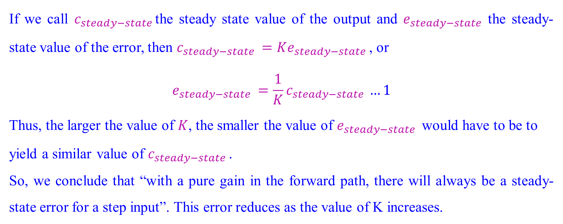
Sources of Steady-State Error
If we call $c_{steady−state }$the steady state value of the output and $e_{steady−state }$the steady-state value of the error, then $c_{steady−state }=Ke_{steady−state }$, or
$$e_{steady−state }=\frac{1}{K}c_{steady−state }…1$$
Thus, the larger the value of $K$, the smaller the value of $e_{steady−state }$ would have to be to
yield a similar value of $c_{steady−state }$.
So, we conclude that “with a pure gain in the forward path, there will always be a steady-state error for a step input”. This error reduces as the value of K increases.

Slide 16
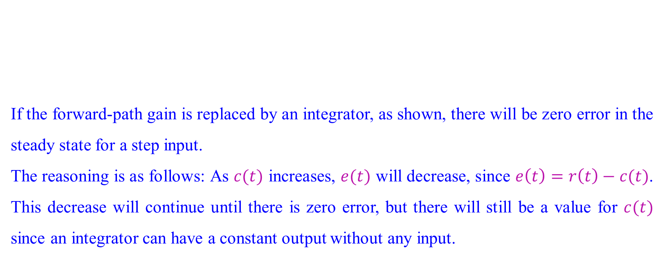
Sources of Steady-State Error
If the forward-path gain is replaced by an integrator, as shown, there will be zero error in the steady state for a step input.
The reasoning is as follows: As $c(t)$ increases, $e(t)$ will decrease, since $e\left(t\right)=r\left(t\right)−c(t)$. This decrease will continue until there is zero error, but there will still be a value for $c(t)$ since an integrator can have a constant output without any input.

Slide 17
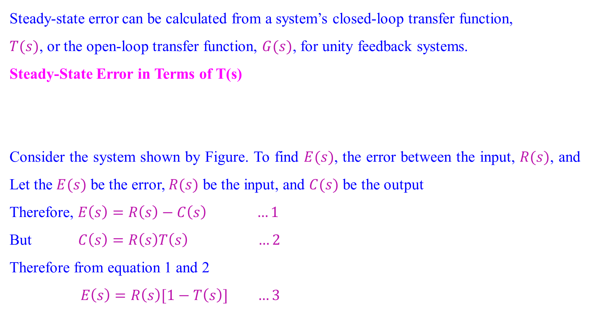
Steady-State Error for Unity Feedback Systems
Steady-state error can be calculated from a system’s closed-loop transfer function,
$T(s)$, or the open-loop transfer function, $G(s)$, for unity feedback systems.
Steady-State Error in Terms of T(s)
Consider the system shown by Figure. To find $E(s)$, the error between the input, $R(s)$, and Let the $E(s)$ be the error, $R(s)$ be the input, and $C(s)$ be the output
Therefore, $E\left(s\right)=R\left(s\right)−C\left(s\right) …1$
But $C\left(s\right)=R\left(s\right)T\left(s\right) …2$
Therefore from equation 1 and 2
$$E\left(s\right)=R\left(s\right)[1−T\left(s\right)] …3$$

Slide 18
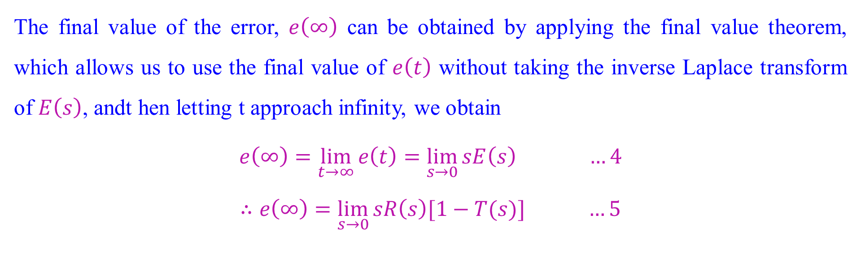
Steady-State Error for Unity Feedback Systems
The final value of the error, $e\left(∞\right)$ can be obtained by applying the final value theorem, which allows us to use the final value of $e\left(t\right)$ without taking the inverse Laplace transform of $E\left(s\right)$, andt hen letting t approach infinity, we obtain
$$e\left(∞\right)=\lim_{t→∞}{e\left(t\right)}=\lim_{s→0}{sE\left(s\right)} …4$$
$$∴e\left(∞\right)=\lim_{s→0}{sR\left(s\right)[1−T(s)]} …5$$

Slide 19
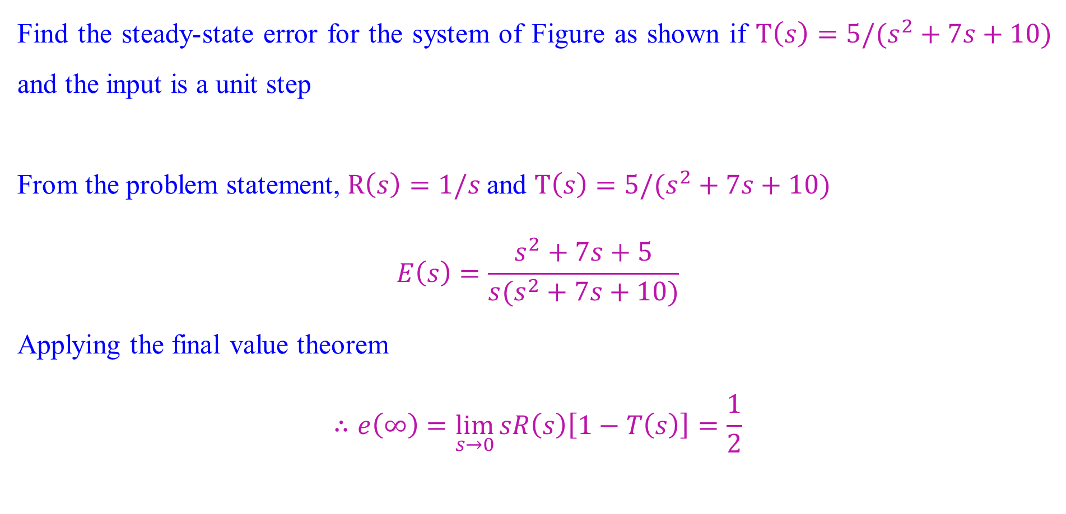
Steady-State Error for Unity Feedback Systems
Find the steady-state error for the system of Figure as shown if $T\left(s\right)=5/(s^{2}+7s+10)$ and the input is a unit step
From the problem statement, $R\left(s\right)=1/s$and $T\left(s\right)=5/(s^{2}+7s+10)$
$$E\left(s\right)=\frac{s^{2}+7s+5}{s(s^{2}+7s+10)}$$
Applying the final value theorem
$$∴e\left(∞\right)=\lim_{s→0}{sR\left(s\right)\left[1−T\left(s\right)\right]=\frac{1}{2}}$$

Slide 20
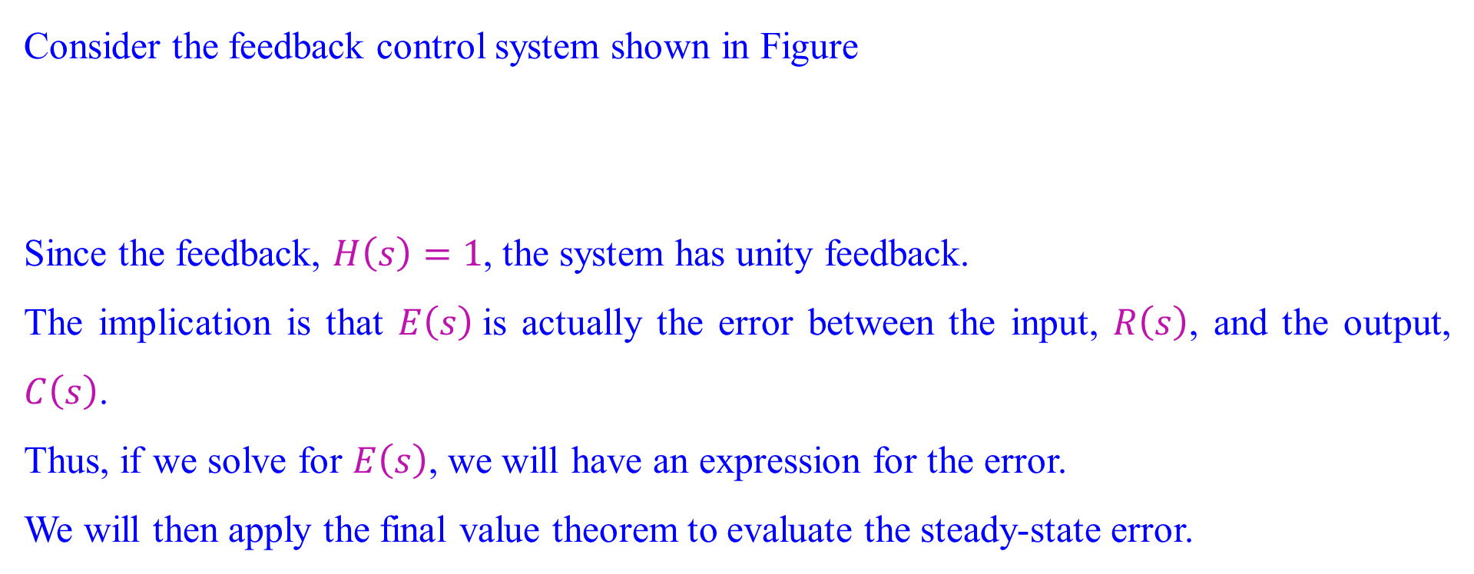
Steady-State Error in Terms of G(s)
Consider the feedback control system shown in Figure
Since the feedback, $H\left(s\right)=1$, the system has unity feedback.
The implication is that $E\left(s\right)$is actually the error between the input, $R\left(s\right)$, and the output, $C\left(s\right)$.
Thus, if we solve for $E\left(s\right)$, we will have an expression for the error.
We will then apply the final value theorem to evaluate the steady-state error.

Slide 21
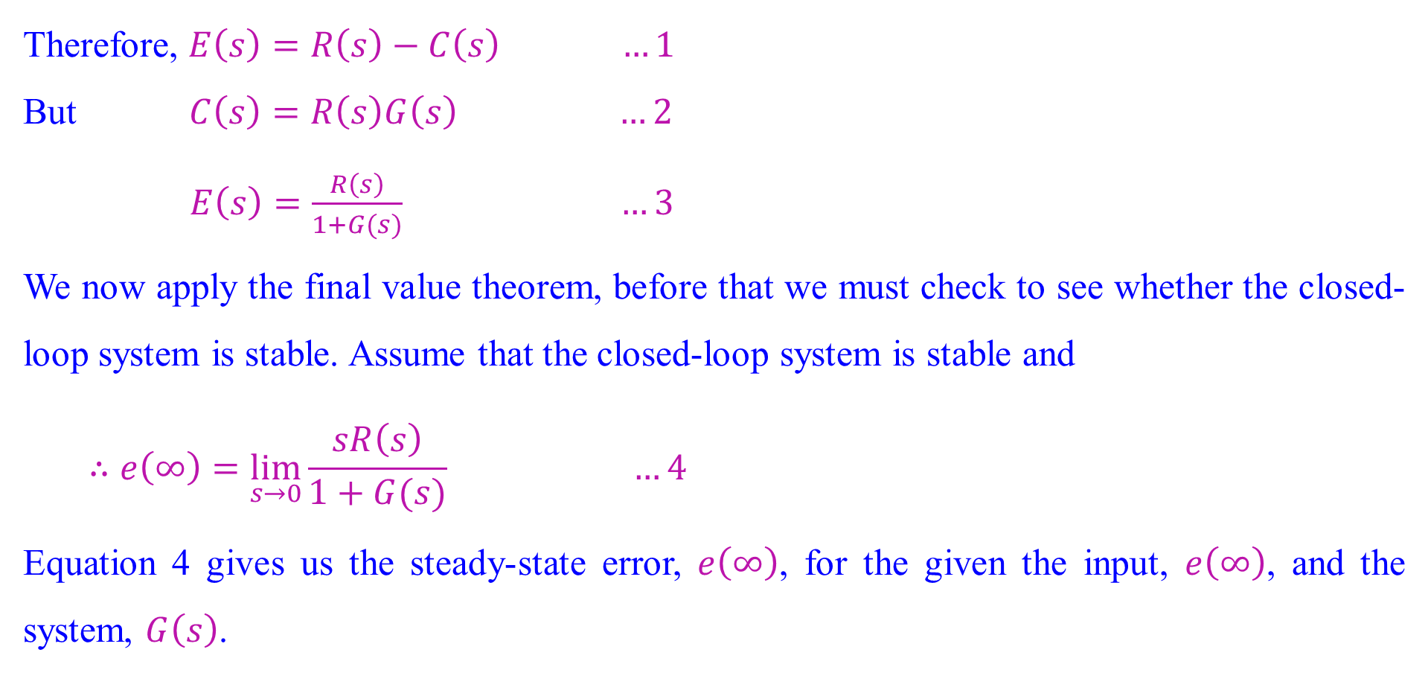
Steady-State Error in Terms of G(s)
Therefore, $E\left(s\right)=R\left(s\right)−C\left(s\right) …1$
But $C\left(s\right)=R\left(s\right)G\left(s\right) …2$
$E\left(s\right)=\frac{R\left(s\right)}{1+G(s)} …3$
We now apply the final value theorem, before that we must check to see whether the closed-loop system is stable. Assume that the closed-loop system is stable and
$$∴e\left(∞\right)=\lim_{s→0}{\frac{sR\left(s\right)}{1+G(s)}} …4$$
Equation 4 gives us the steady-state error, $e\left(∞\right)$, for the given the input, $e\left(∞\right)$, and the system, $G\left(s\right)$.

Slide 22
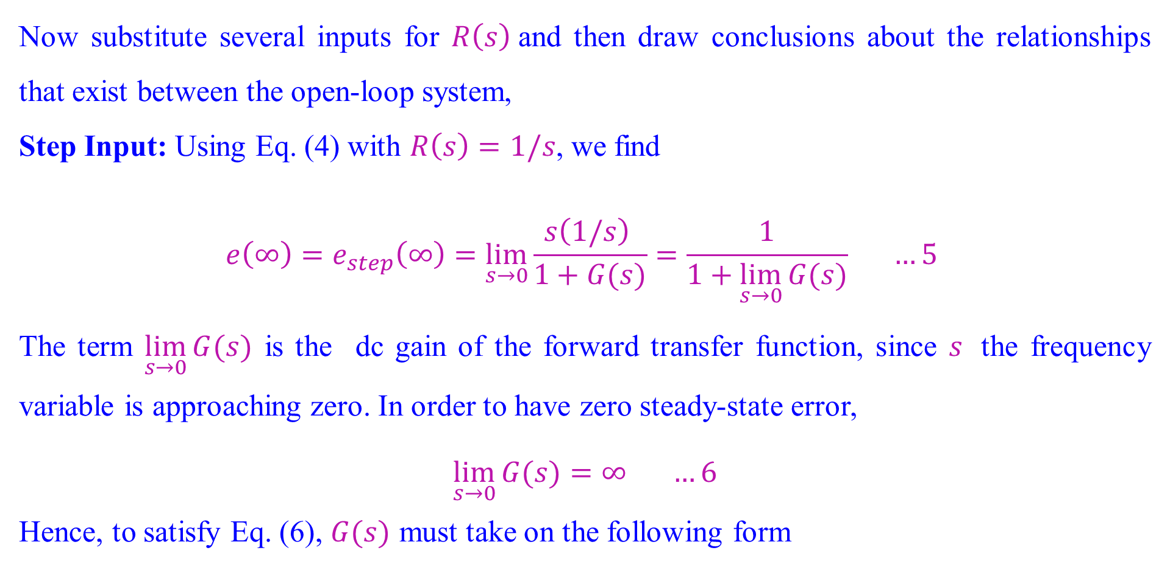
Steady-State Error in Terms of G(s): Step input
Now substitute several inputs for $R\left(s\right)$and then draw conclusions about the relationships that exist between the open-loop system,
Step Input: Using Eq. (4) with $R\left(s\right)=1/s$, we find
$$e\left(∞\right)=e_{step}\left(∞\right)=\lim_{s→0}{\frac{s\left(1/s\right) }{1+G(s)}}=\frac{1}{1+\lim_{s→0}{G(s)}} …5$$
The term $\lim_{s→0}{G(s)}$ is the dc gain of the forward transfer function, since $s$ the frequency variable is approaching zero. In order to have zero steady-state error,
$$\lim_{s→0}{G(s)}=∞ …6$$
Hence, to satisfy Eq. (6), $G(s)$ must take on the following form

Slide 23
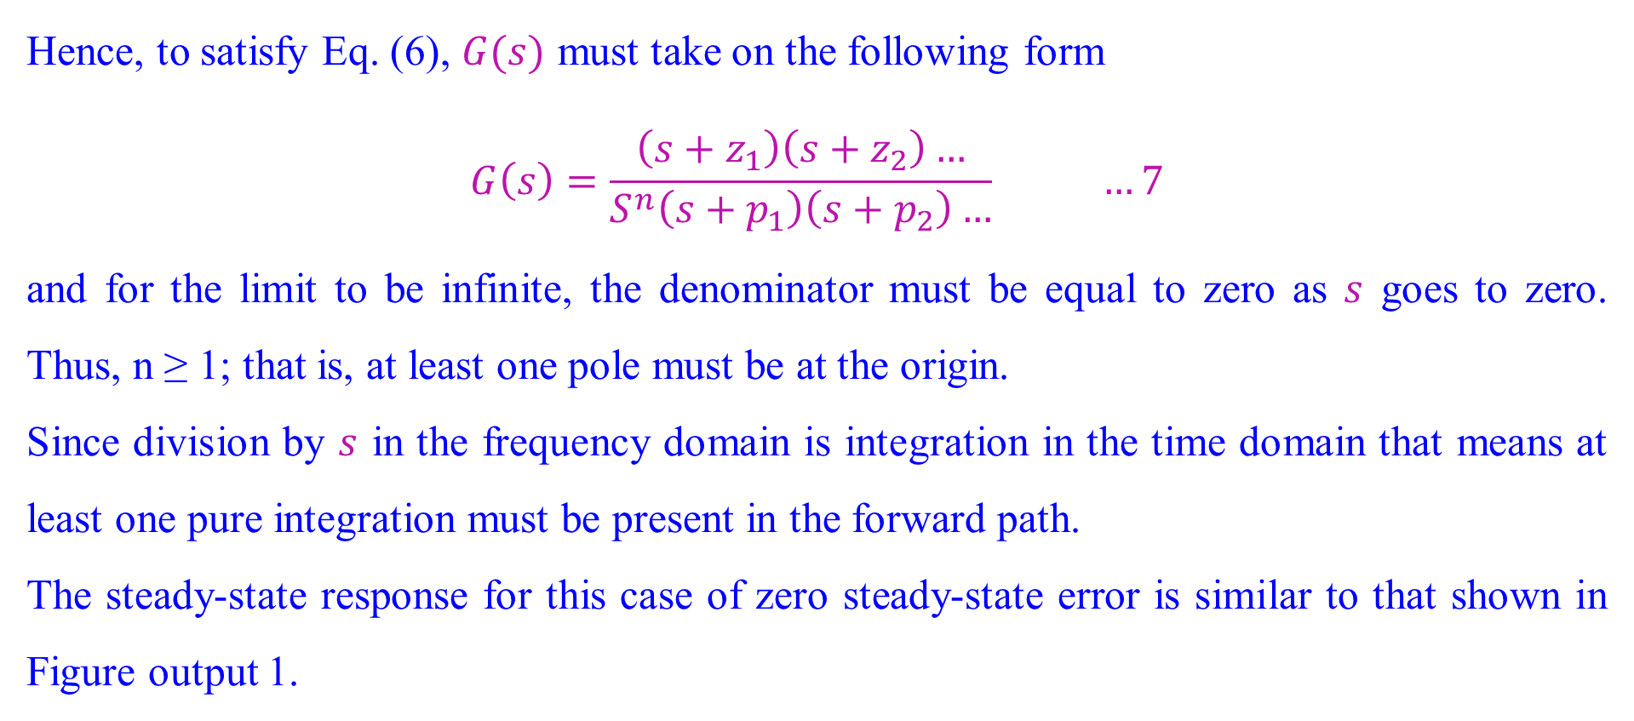
Steady-State Error in Terms of G(s) : Step input
Hence, to satisfy Eq. (6), $G(s)$ must take on the following form
$$G\left(s\right)=\frac{\left(s+z_{1}\right)\left(s+z_{2}\right)…}{S^{n}\left(s+p_{1}\right)\left(s+p_{2}\right)…} …7$$
and for the limit to be infinite, the denominator must be equal to zero as $s$ goes to zero. Thus, n ≥ 1; that is, at least one pole must be at the origin.
Since division by $s$ in the frequency domain is integration in the time domain that means at least one pure integration must be present in the forward path.
The steady-state response for this case of zero steady-state error is similar to that shown in Figure output 1.

Slide 24
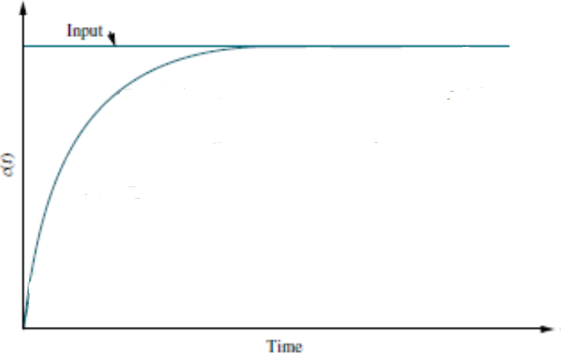
Steady-State Error in Terms of G(s) : Step input
The steady-state response for this case of zero steady-state error is shown in Figure.

Slide 25
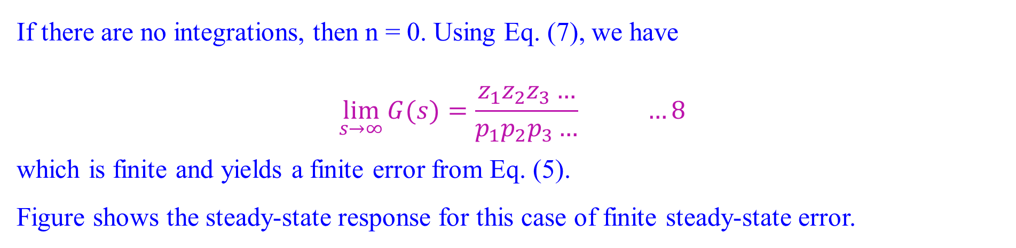
Steady-State Error in Terms of G(s) : Step input
If there are no integrations, then n = 0. Using Eq. (7), we have
$$\lim_{s→∞}{G(s)}=\frac{z_{1}z_{2}z_{3}…}{p_{1}p_{2}p_{3}…} …8$$
which is finite and yields a finite error from Eq. (5).
Figure shows the steady-state response for this case of finite steady-state error.

Slide 26
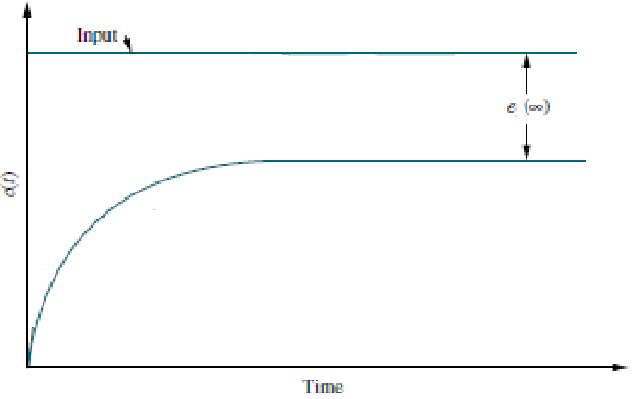
Steady-State Error in Terms of G(s) : Step input
Figure shows the steady-state response for this case of finite steady-state error.

Slide 27
Steady-State Error in Terms of G(s) : Step input
Therefore, for a step input to a unity feedback system,
the steady-state error will be zero if there is at least one pure integration in the forward path.
If there are no integrations, then there will be a nonzero finite error.

Slide 28
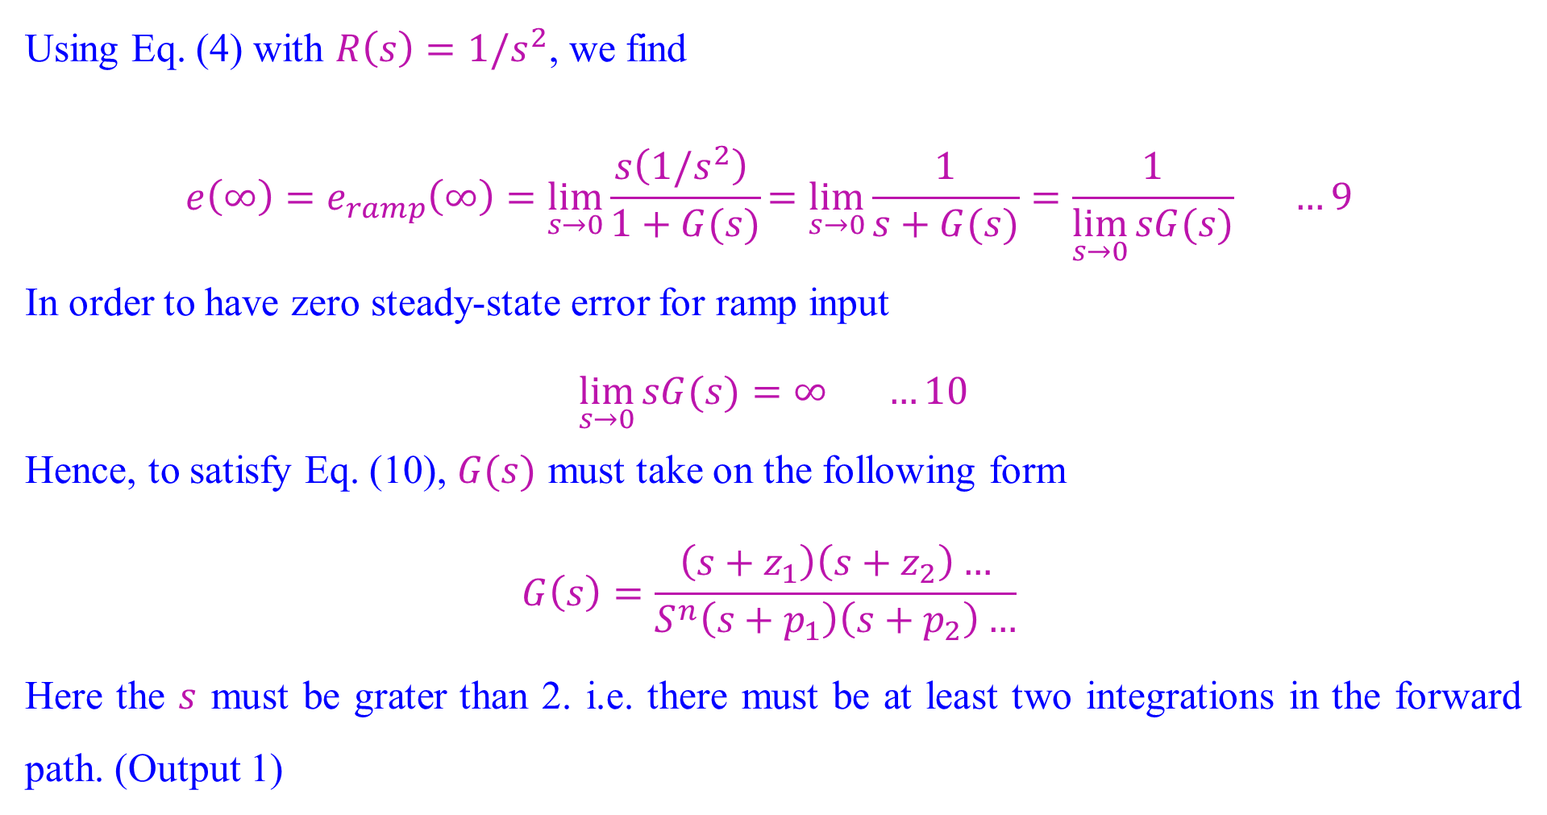
Steady-State Error in Terms of G(s): Ramp Input
Using Eq. (4) with $R\left(s\right)=1/s^{2}$, we find
$$e\left(∞\right)=e_{ramp}\left(∞\right)=\lim_{s→0}{\frac{s\left(1/s^{2}\right) }{1+G(s)}}=\lim_{s→0}{\frac{1}{s+G(s)}}=\frac{1}{\lim_{s→0}{sG(s)}} …9$$
In order to have zero steady-state error for ramp input
$$\lim_{s→0}{sG(s)}=∞ …10$$
Hence, to satisfy Eq. (10), $G(s)$ must take on the following form
$$G\left(s\right)=\frac{\left(s+z_{1}\right)\left(s+z_{2}\right)…}{S^{n}\left(s+p_{1}\right)\left(s+p_{2}\right)…}$$
Here the $s$ must be grater than 2. i.e. there must be at least two integrations in the forward path. (Output 1)

Slide 29
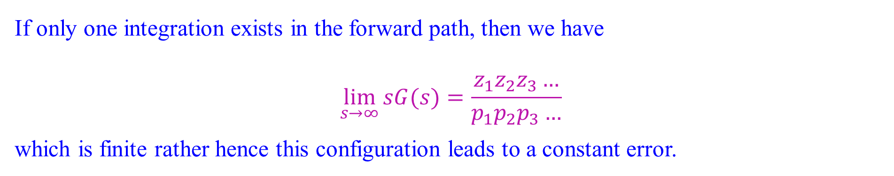
Steady-State Error in Terms of G(s): Ramp Input
If only one integration exists in the forward path, then we have
$$\lim_{s→∞}{sG(s)}=\frac{z_{1}z_{2}z_{3}…}{p_{1}p_{2}p_{3}…}$$
which is finite rather hence this configuration leads to a constant error.

Slide 30
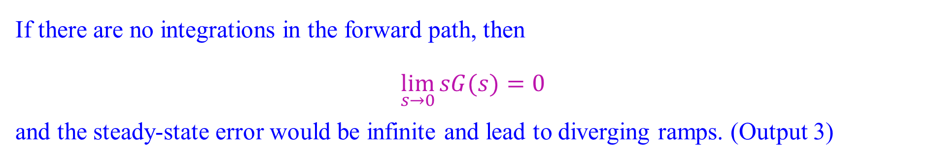
Steady-State Error in Terms of G(s): Ramp Input
If there are no integrations in the forward path, then
$$\lim_{s→0}{sG(s)}=0$$
and the steady-state error would be infinite and lead to diverging ramps. (Output 3)

Slide 31
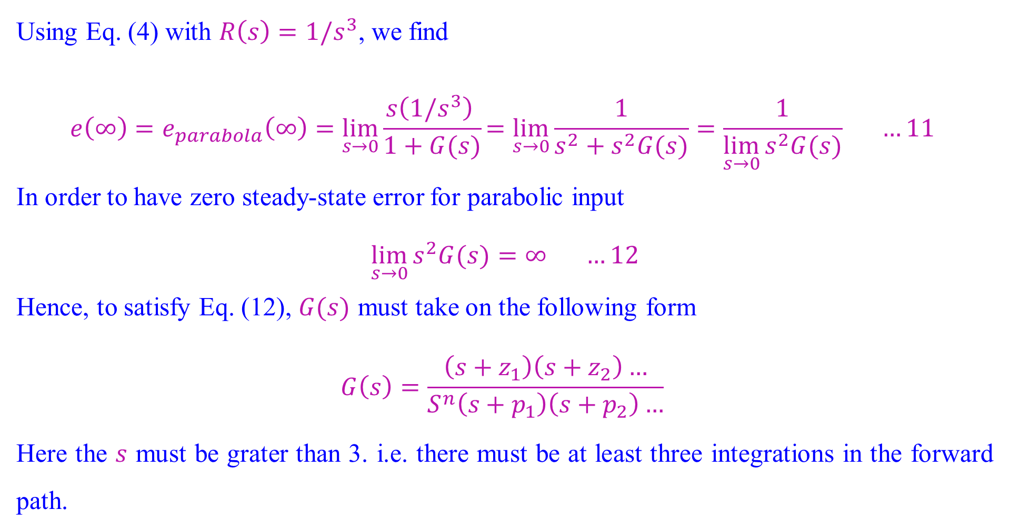
Steady-State Error in Terms of G(s): Parabola Input
Using Eq. (4) with $R\left(s\right)=1/s^{3}$, we find
$$e\left(∞\right)=e_{parabola}\left(∞\right)=\lim_{s→0}{\frac{s\left(1/s^{3}\right) }{1+G(s)}}=\lim_{s→0}{\frac{1}{s^{2}+s^{2}G(s)}}=\frac{1}{\lim_{s→0}{s^{2}G(s)}} …11$$
In order to have zero steady-state error for parabolic input
$$\lim_{s→0}{s^{2}G(s)}=∞ …12$$
Hence, to satisfy Eq. (12), $G(s)$ must take on the following form
$$G\left(s\right)=\frac{\left(s+z_{1}\right)\left(s+z_{2}\right)…}{S^{n}\left(s+p_{1}\right)\left(s+p_{2}\right)…}$$
Here the $s$ must be grater than 3. i.e. there must be at least three integrations in the forward path.

Slide 32
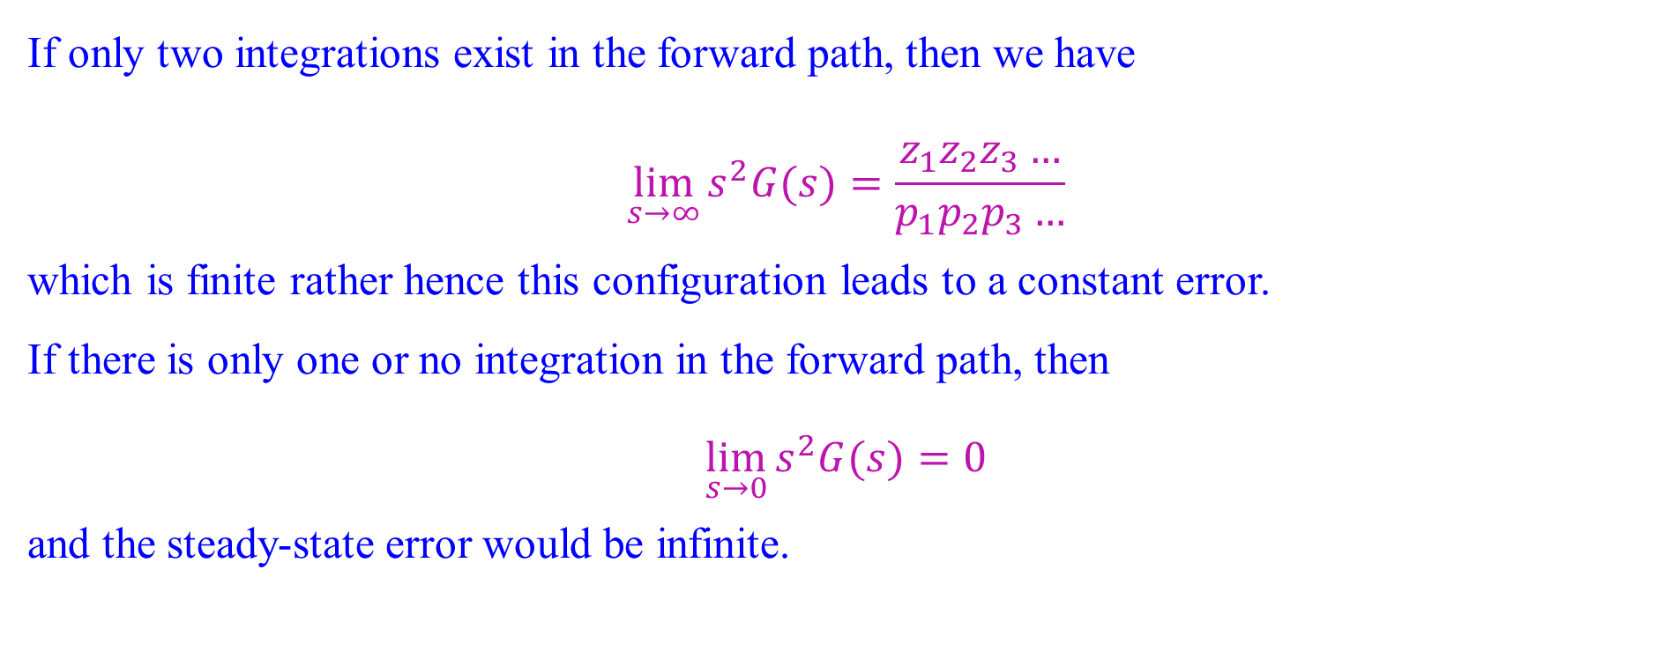
Steady-State Error in Terms of G(s): Parabola Input
If only two integrations exist in the forward path, then we have
$$\lim_{s→∞}{s^{2}G(s)}=\frac{z_{1}z_{2}z_{3}…}{p_{1}p_{2}p_{3}…}$$
which is finite rather hence this configuration leads to a constant error.
If there is only one or no integration in the forward path, then
$$\lim_{s→0}{s^{2}G(s)}=0$$
and the steady-state error would be infinite.

Slide 33
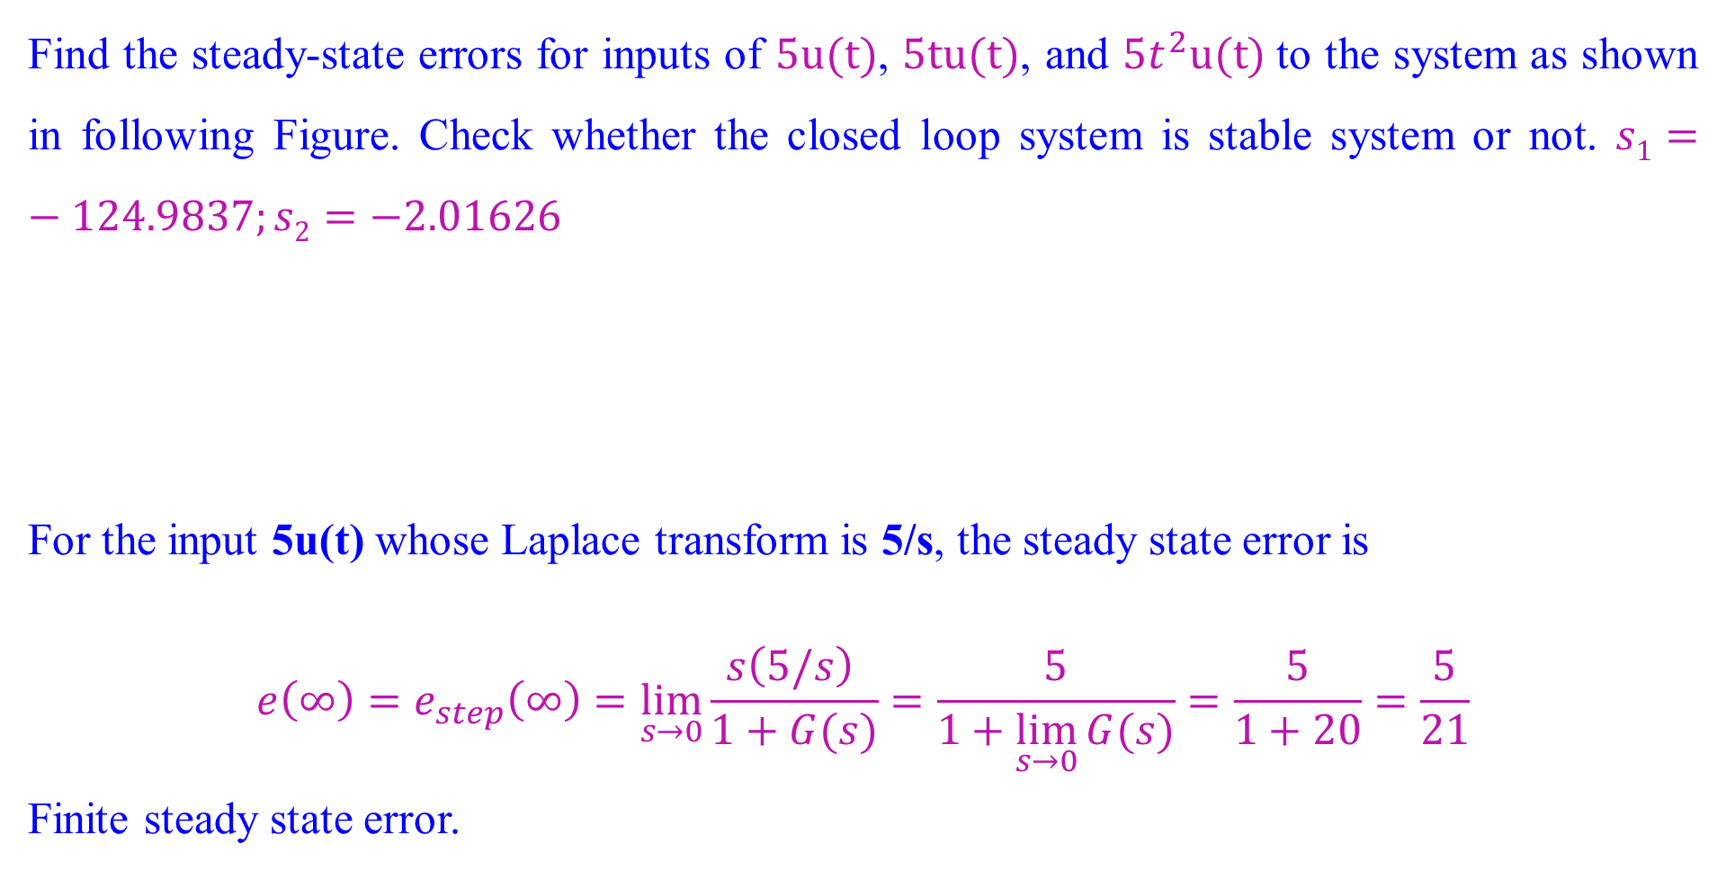
Steady-State Error in Terms of G(s): Numerical
Find the steady-state errors for inputs of $5u(t)$, $5tu(t)$, and $5t^{2}u(t)$to the system as shown in following Figure. Check whether the closed loop system is stable system or not. $s1=−124.9837;s2=−2.01626$
For the input 5u(t) whose Laplace transform is 5/s, the steady state error is
$$e\left(∞\right)=e_{step}\left(∞\right)=\lim_{s→0}{\frac{s\left(5/s\right) }{1+G(s)}}=\frac{5}{1+\lim_{s→0}{G(s)}}=\frac{5}{1+20}=\frac{5}{21}$$
Finite steady state error.

Slide 34
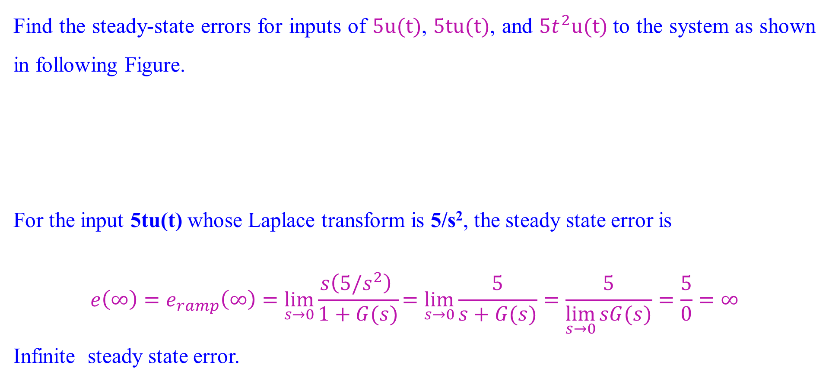
Steady-State Error in Terms of G(s): Numerical
Find the steady-state errors for inputs of $5u(t)$, $5tu(t)$, and $5t^{2}u(t)$to the system as shown in following Figure.
For the input 5tu(t) whose Laplace transform is 5/s², the steady state error is
$$e\left(∞\right)=e_{ramp}\left(∞\right)=\lim_{s→0}{\frac{s\left(5/s^{2}\right) }{1+G(s)}}=\lim_{s→0}{\frac{5}{s+G(s)}}=\frac{5}{\lim_{s→0}{sG(s)}}=\frac{5}{0}=∞$$
Infinite steady state error.

Slide 35
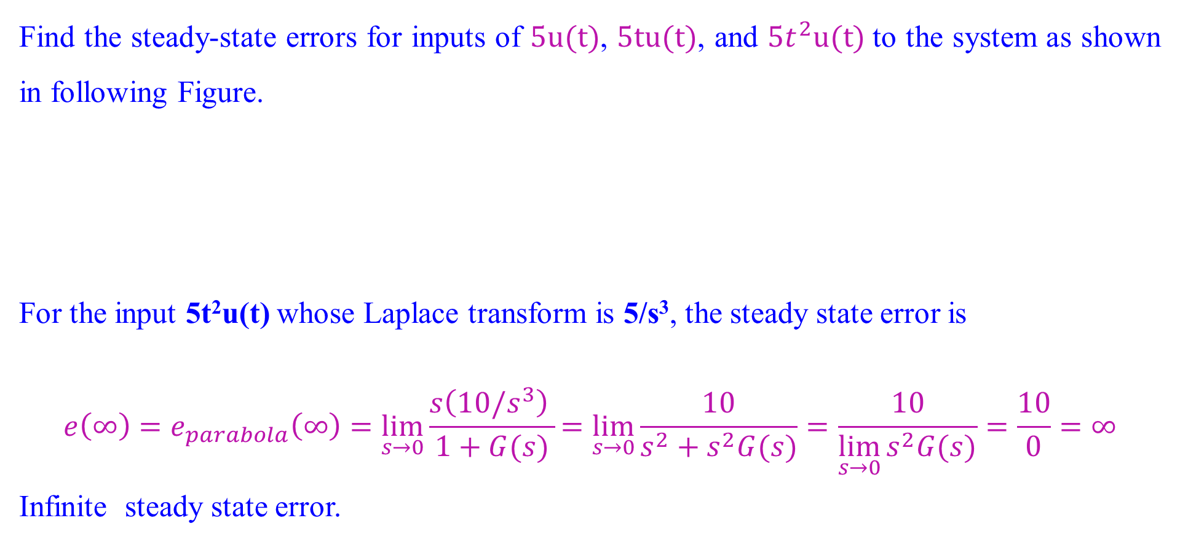
Steady-State Error in Terms of G(s): Numerical
Find the steady-state errors for inputs of $5u(t)$, $5tu(t)$, and $5t^{2}u(t)$to the system as shown in following Figure.
For the input 5t²u(t) whose Laplace transform is 5/s³, the steady state error is
$$e\left(∞\right)=e_{parabola}\left(∞\right)=\lim_{s→0}{\frac{s\left(10/s^{3}\right) }{1+G(s)}}=\lim_{s→0}{\frac{10}{s^{2}+s^{2}G(s)}}=\frac{10}{\lim_{s→0}{s^{2}G(s)}}=\frac{10}{0}=∞$$
Infinite steady state error.

Slide 36
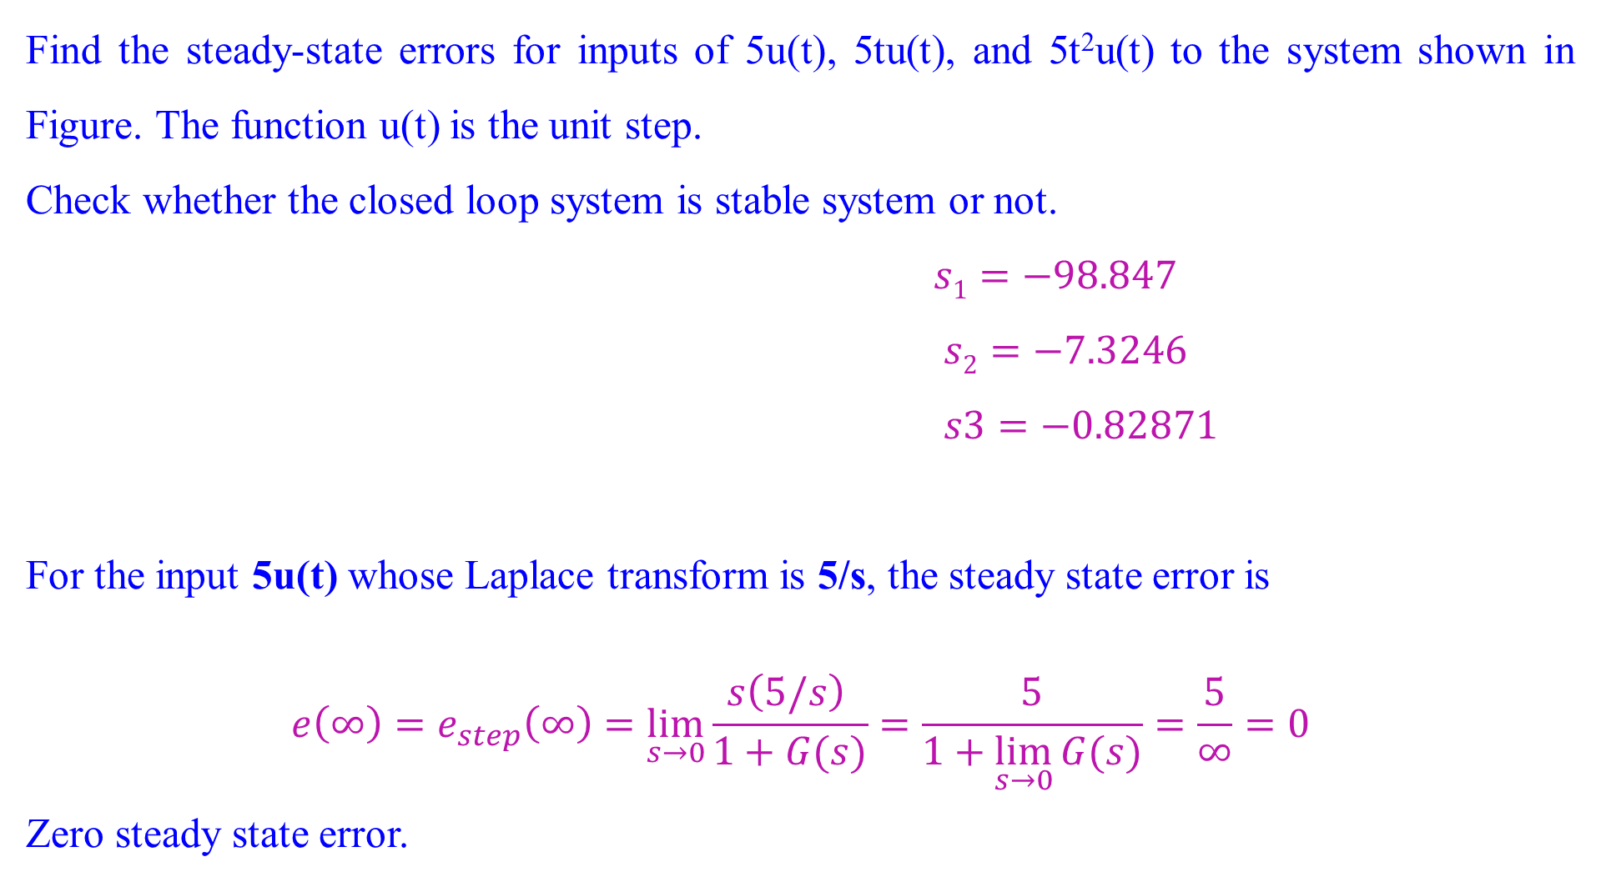
Steady-State Error in Terms of G(s): Numerical 2
Find the steady-state errors for inputs of 5u(t), 5tu(t), and 5t²u(t) to the system shown in Figure. The function u(t) is the unit step.
Check whether the closed loop system is stable system or not.
$s1=−98.847$
$s2=−7.3246$
$s3=−0.82871$
For the input 5u(t) whose Laplace transform is 5/s, the steady state error is
$$e\left(∞\right)=e_{step}\left(∞\right)=\lim_{s→0}{\frac{s\left(5/s\right) }{1+G(s)}}=\frac{5}{1+\lim_{s→0}{G(s)}}=\frac{5}{∞}=0$$
Zero steady state error.

Slide 37
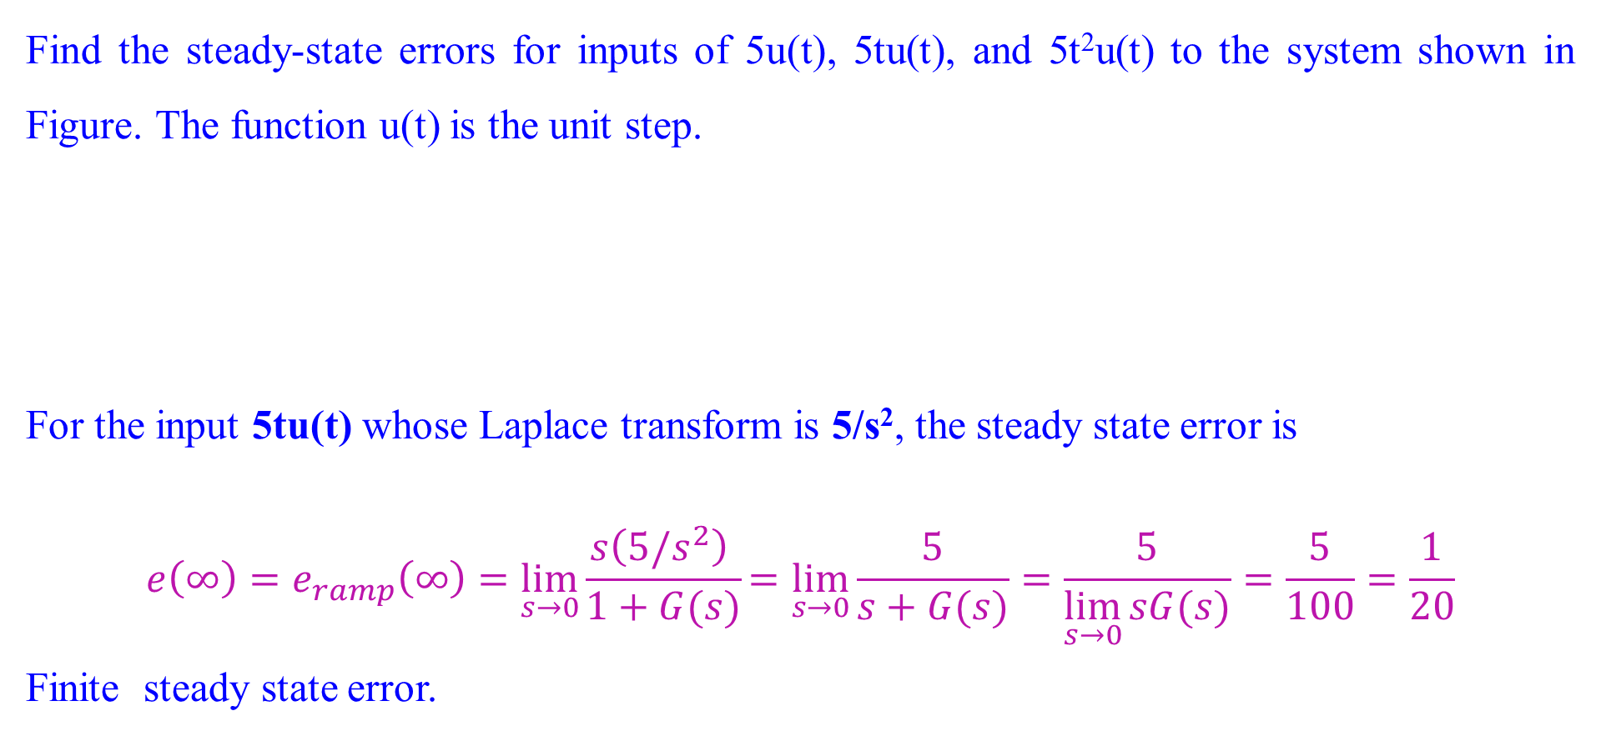
Steady-State Error in Terms of G(s): Numerical 2
Find the steady-state errors for inputs of 5u(t), 5tu(t), and 5t²u(t) to the system shown in Figure. The function u(t) is the unit step.
For the input 5tu(t) whose Laplace transform is 5/s², the steady state error is
$$e\left(∞\right)=e_{ramp}\left(∞\right)=\lim_{s→0}{\frac{s\left(5/s^{2}\right) }{1+G(s)}}=\lim_{s→0}{\frac{5}{s+G(s)}}=\frac{5}{\lim_{s→0}{sG(s)}}=\frac{5}{100}=\frac{1}{20}$$
Finite steady state error.

Slide 38
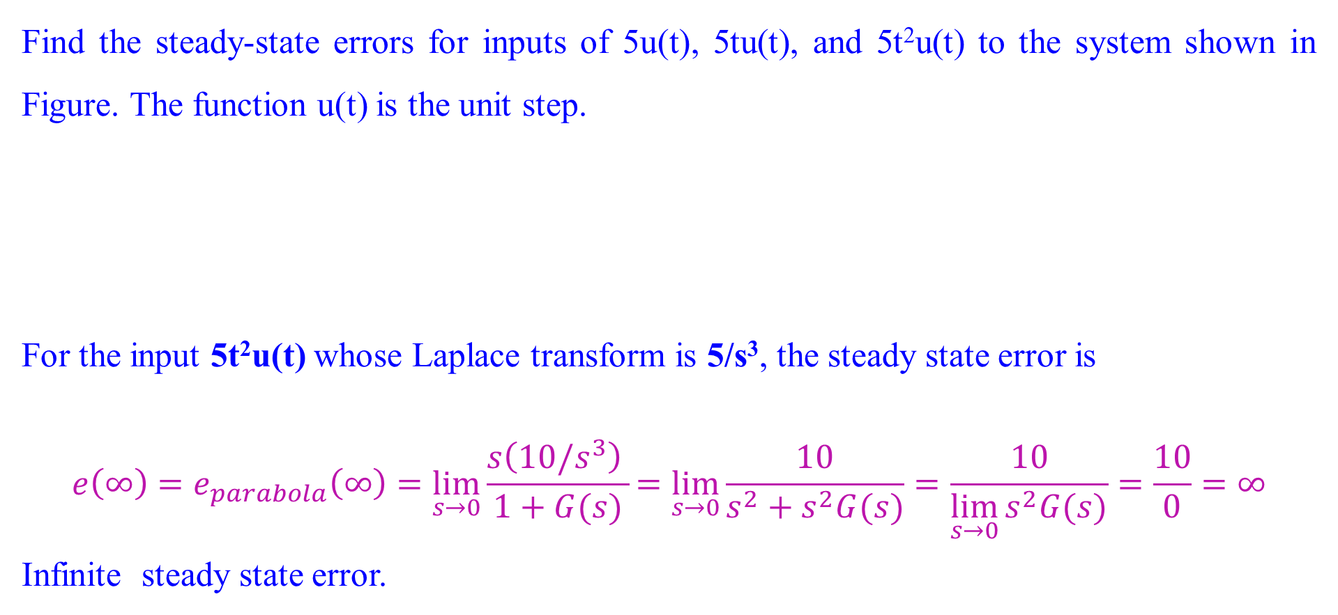
Steady-State Error in Terms of G(s): Numerical 2
Find the steady-state errors for inputs of 5u(t), 5tu(t), and 5t²u(t) to the system shown in Figure. The function u(t) is the unit step.
For the input 5t²u(t) whose Laplace transform is 5/s³, the steady state error is
$$e\left(∞\right)=e_{parabola}\left(∞\right)=\lim_{s→0}{\frac{s\left(10/s^{3}\right) }{1+G(s)}}=\lim_{s→0}{\frac{10}{s^{2}+s^{2}G(s)}}=\frac{10}{\lim_{s→0}{s^{2}G(s)}}=\frac{10}{0}=∞$$
Infinite steady state error.

Slide 39
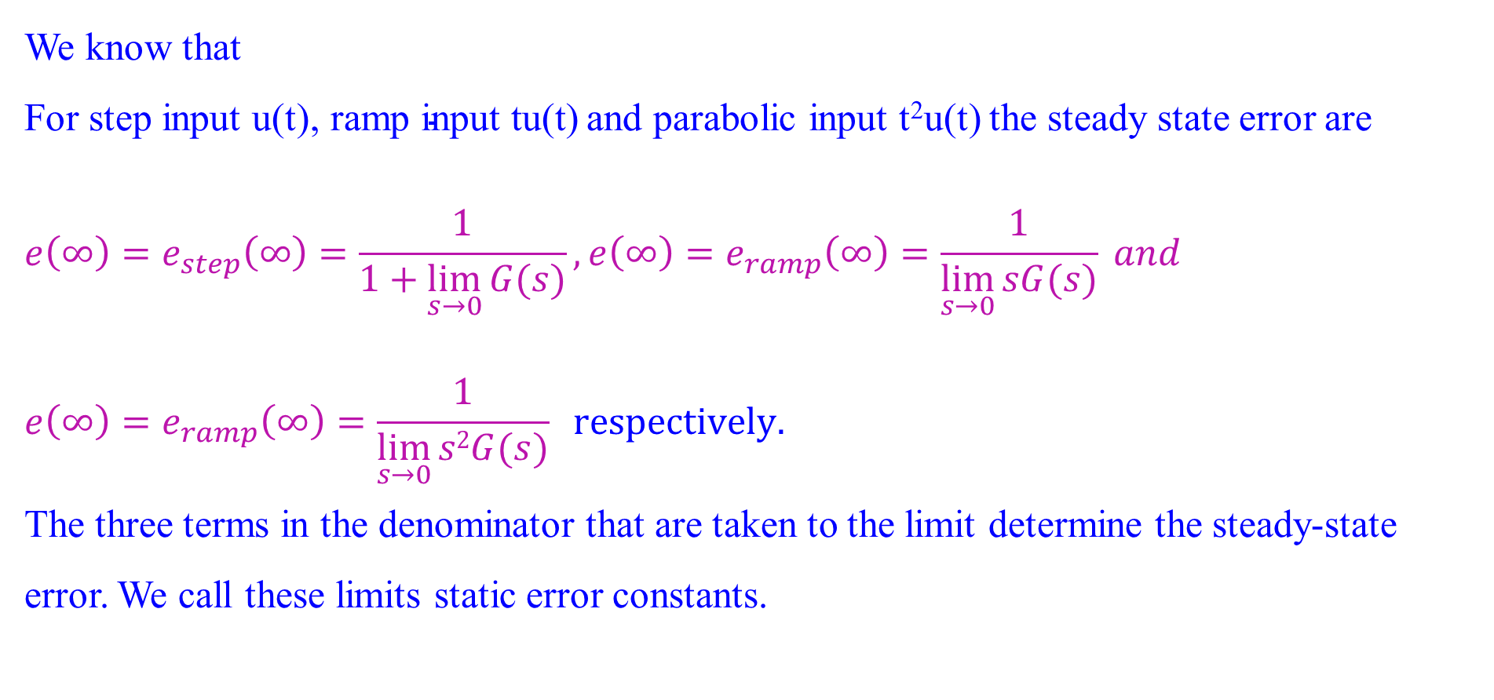
Static Error Constants and System Type
We know that
For step input u(t),$\text{ramp} \text{input} \text{tu}\text{(}\text{t}\text{)}$ and parabolic input t²u(t) the steady state error are
$$e\left(∞\right)=e_{step}\left(∞\right)=\frac{1}{1+\lim_{s→0}{G(s)}},e\left(∞\right)=e_{ramp}\left(∞\right)=\frac{1}{\lim_{s→0}{sG(s)}} and$$
$$e\left(∞\right)=e_{ramp}\left(∞\right)=\frac{1}{\lim_{s→0}{s2G(s)}} respectively.$$
The three terms in the denominator that are taken to the limit determine the steady-state error. We call these limits static error constants.

Slide 40
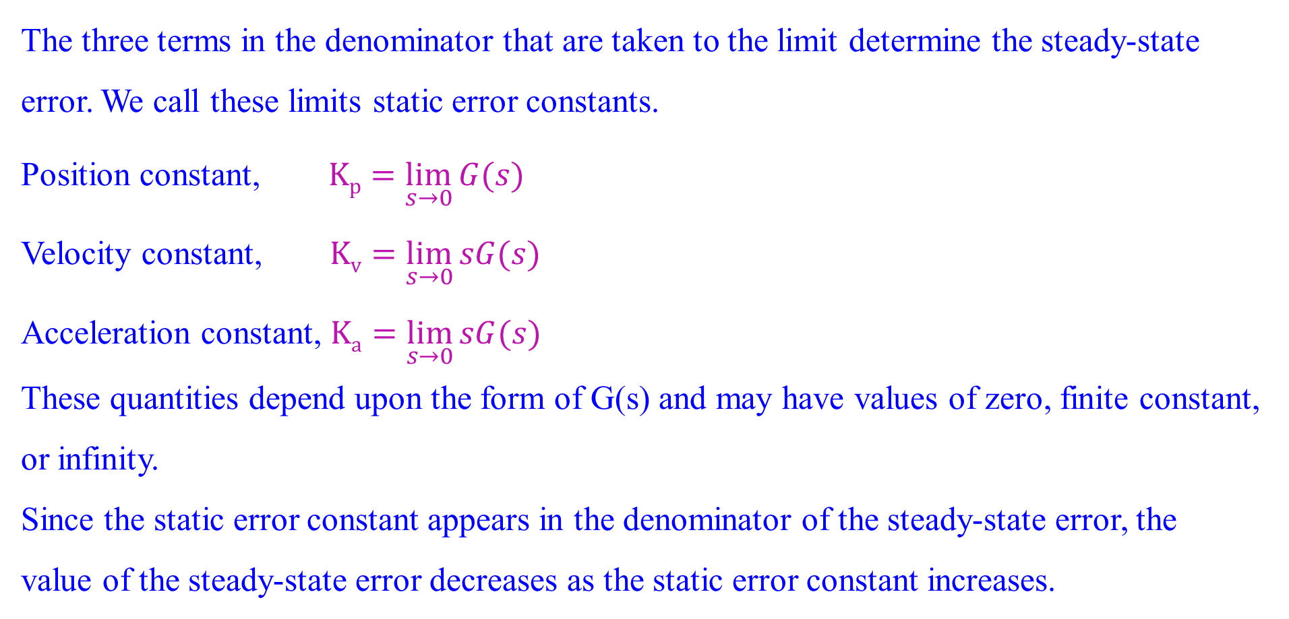
Static Error Constants and System Type
The three terms in the denominator that are taken to the limit determine the steady-state error. We call these limits static error constants.
Position constant, $Kp=\lim_{s→0}{G(s)}$
Velocity constant, $Kv=\lim_{s→0}{sG(s)}$
Acceleration constant, $Ka=\lim_{s→0}{sG(s)}$
These quantities depend upon the form of G(s) and may have values of zero, finite constant, or infinity.
Since the static error constant appears in the denominator of the steady-state error, the
value of the steady-state error decreases as the static error constant increases.

Slide 41
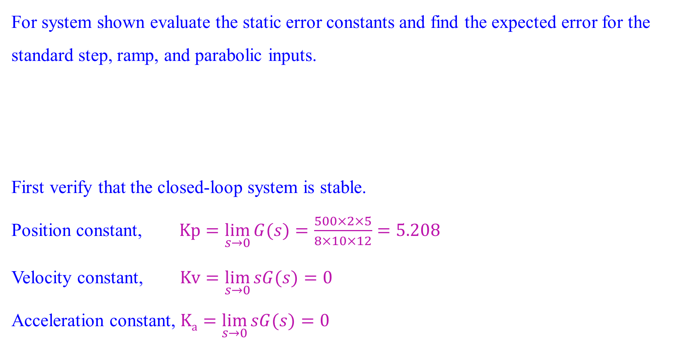
Static Error Constants and System Type
For system shown evaluate the static error constants and find the expected error for the standard step, ramp, and parabolic inputs.
First verify that the closed-loop system is stable.
Position constant, $Kp=\lim_{s→0}{G(s)}=\frac{500×2×5}{8×10×12}=5.208$
Velocity constant, $Kv=\lim_{s→0}{sG(s)}=0$
Acceleration constant, $Ka=\lim_{s→0}{sG(s)}=0$

Slide 42
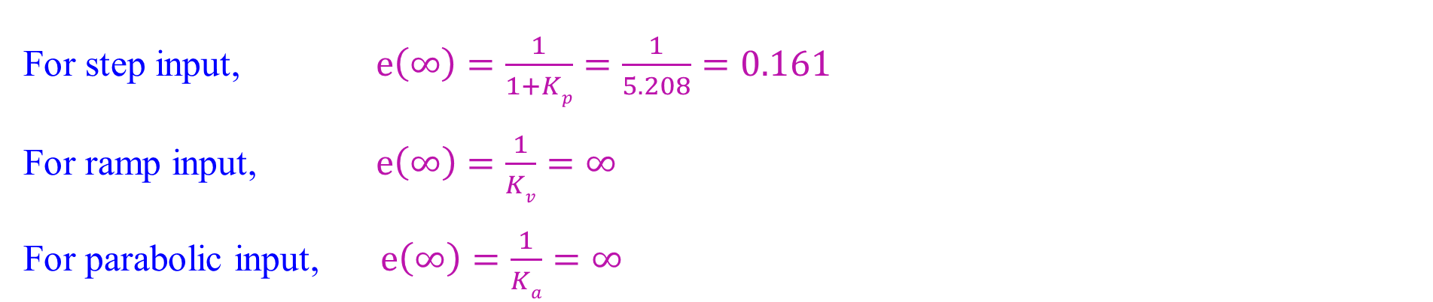
Static Error Constants and System Type
For step input, $e\left(∞\right)=\frac{1}{1+Kp}=\frac{1}{5.208}=0.161$
For ramp input, $e\left(∞\right)=\frac{1}{Kv}=∞$
For parabolic input, $e\left(∞\right)=\frac{1}{Ka}=∞$

Slide 43
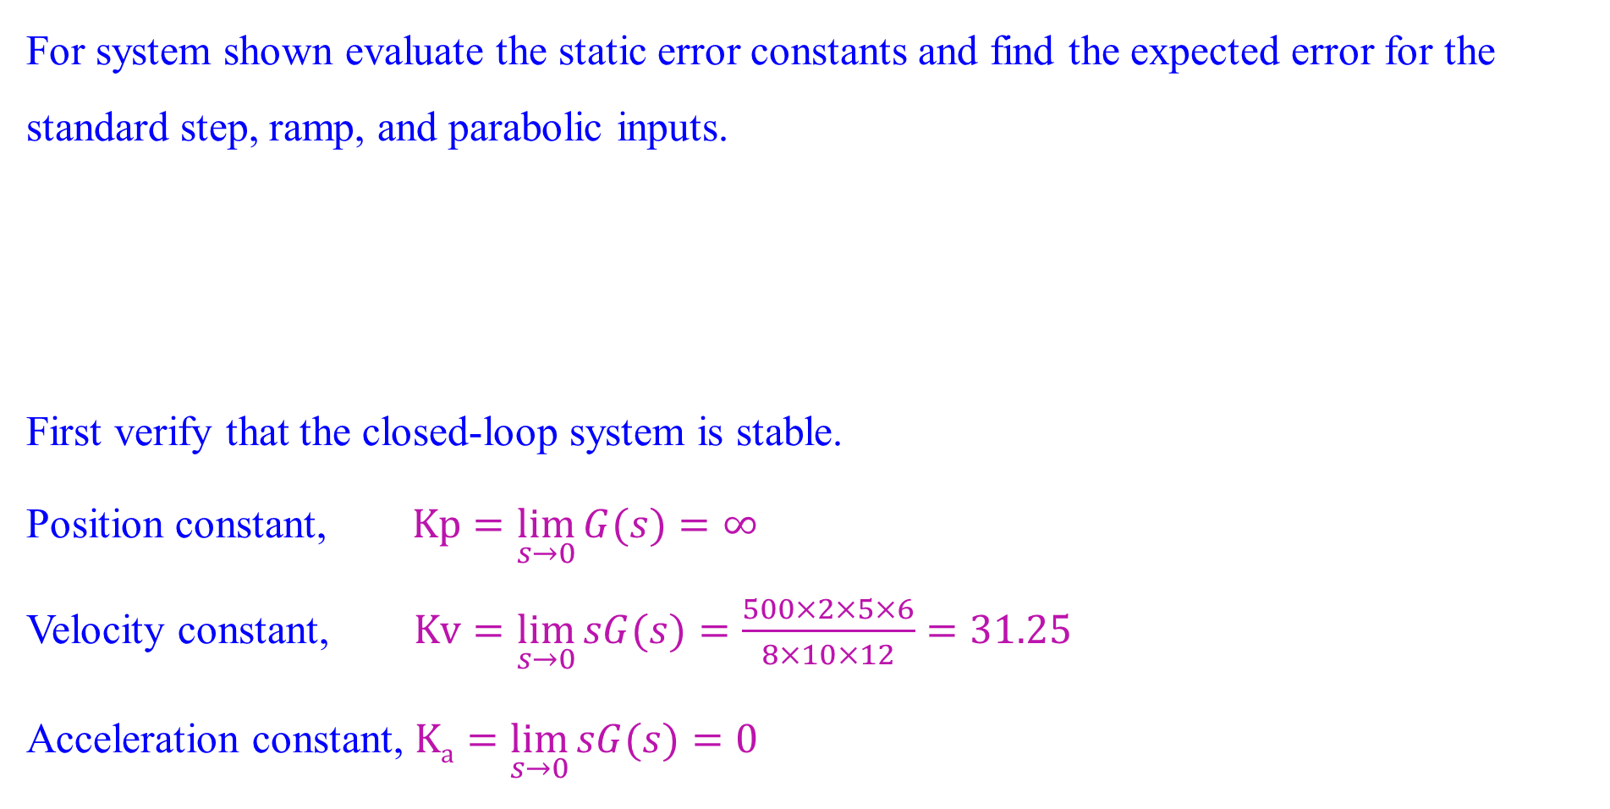
Static Error Constants and System Type
For system shown evaluate the static error constants and find the expected error for the standard step, ramp, and parabolic inputs.
First verify that the closed-loop system is stable.
Position constant, $Kp=\lim_{s→0}{G(s)}=∞$
Velocity constant, $Kv=\lim_{s→0}{sG(s)}=\frac{500×2×5×6}{8×10×12}=31.25$
Acceleration constant, $Ka=\lim_{s→0}{sG(s)}=0$

Slide 44
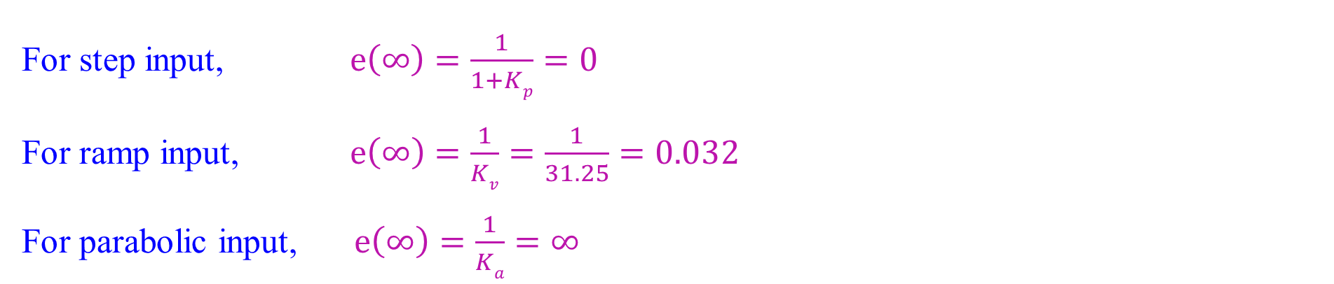
Static Error Constants and System Type
For step input, $e\left(∞\right)=\frac{1}{1+Kp}=0$
For ramp input, $e\left(∞\right)=\frac{1}{Kv}=\frac{1}{31.25}=0.032$
For parabolic input, $e\left(∞\right)=\frac{1}{Ka}=∞$

Slide 45
System Type
The values of the static error constants, again, depend upon the form of G(s), especially the number of pure integrations in the forward path.
Since steady-state errors are dependent upon the number of integrations in the forward path, we give a name to this system attribute.
Consider the system shown, we define system type to be the value of n in the denominator i.e. the number of pure integrations in the forward path. Therefore, a system with n = 0 is a Type 0 system. If n = 1 or n = 2, the corresponding system is a Type 1 or Type 2 system, respectively.

Slide 46
System Type
Relationships between input, system type, static error constants, and steady-state errors

Slide 47
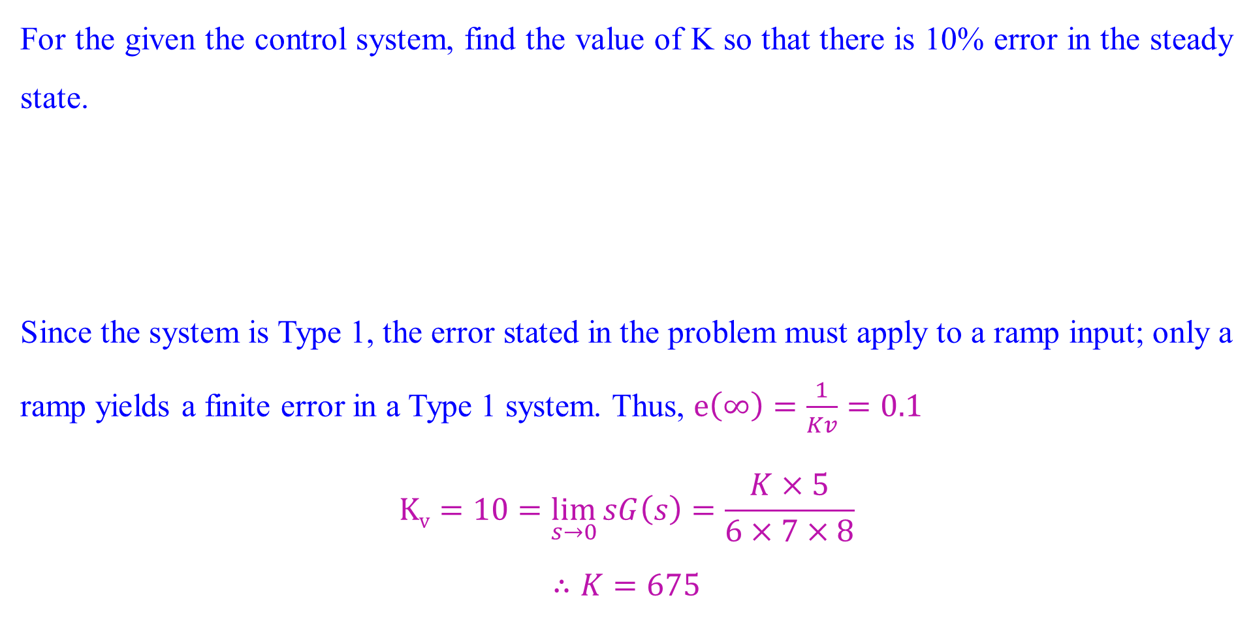
System Type
For the given the control system, find the value of K so that there is 10% error in the steady state.
Since the system is Type 1, the error stated in the problem must apply to a ramp input; only a ramp yields a finite error in a Type 1 system. Thus, $e\left(∞\right)=\frac{1}{Kv}=0.1$
$$Kv=10=\lim_{s→0}{sG\left(s\right)=\frac{K×5}{6×7×8}}$$
$$∴K=675$$

